Slide 1
Chapter 2: Introduction to Mobile Application Concept & Development
INTRODUCTION TO MOBILE APPLICATION (TSE3383)

Slide 2
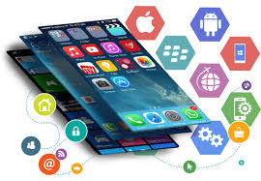
Introduction to Mobile Application
Most commonly referred to as an app
Mobile App is a type of application software designed to run on a mobile device, such as a smartphone or tablet computer.
Mobile applications frequently serve to provide users with similar services to those accessed on PCs.
Apps are generally small, individual software units with limited function.
A mobile application also may be known as an app, web app, online app, iPhone app or smartphone app.

Slide 3
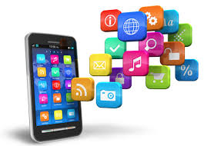
Introduction to Mobile Application (cont..)
The purposes of these apps is to provide utility, productivity, and navigation to entertainment, sports, fitness, and just about any other imaginable.
Apps offers more interactivity, and presents more specific information in a format that's easy and intuitive to use on a mobile device.

Slide 4
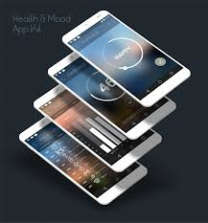
Important Characteristics of Mobile Applications
Quick startup time is an important characteristic of mobile applications.
Responsiveness and users receive some type of acknowledgment immediately upon performing an action on a device.
The application must have a clearly purpose defined set of things it does very well.
Customized Interactions with Off-Device Information Sources that expose services to mobile devices should be given proper consideration in the application’s design to ensure that they are returning information in a way that is appropriate for mobile devices.
Keep your mobile application simplicity ( 'clean' and 'simple‘)

Slide 5

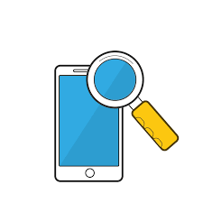
Important Characteristics of Mobile Applications (cont..)
Integrating social media sharing has become a 'necessary' for every mobile application.
Mobile apps need good data security to download and avoid collecting unnecessary data from the user’s mobile phone.
Be open to everyone and engage clients in mutual communication. It is the easiest way to get feedback from users, which shall help developer shape the future of the application.
If developer wants to engage the customers, add features allowing them to customize font images, colors, etc.
Search function should be included when the app delivers a lot of content. Make every page and every service easy to find.

Slide 6
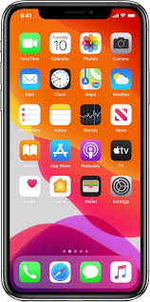
The Goals of Mobile Application
Conformance to the purposes of users.
Capability to reach the majority of users.
Capability to be secured.
Being user-friendly.
Supporting continuous improvement and engagement.

Slide 7
The Challenges of Mobile Applications
Small screen size. On a mobile platform, it is difficult or impossible to view text and graphics like on a desktop computer screen.
Lack of windows. We can see many windows at a time on a desktop. However, it can hardly be realized on a mobile platform.
Navigation. Most mobile devices do not have mouse like pointer, so it has limited flexibility in navigation.
Types of pages accessible. As a rule, mobile platforms do not support all types of file formats.
Speed. The speed of processing and speed of connectivity of mobile platforms is slow.
Size of messages or email. Many devices support limited number of characters in message or email.
Cost. The cost for cellphones, mobile applications and Internet connection is high

Slide 8

Questions About Your Privacy
When you sign up with an app store or download individual apps, you may be asked for permission to let them access information on your device. Some apps may be able to access:
your phone and email contacts
call logs
internet data
calendar data
data about the device’s location
the device’s unique IDs
information about how you use the app itself
Notes:
Some apps access only the data they need to function; others access data that’s not related to the purpose of the app.
Remember that someone may be collecting data on the websites you visit, the apps you use, and the information you provide when you’re using the device – whether it’s the app developer, the app store, an advertiser, or an ad network. And if they’re collecting your data, they may share it with other companies.
If you are concerned about how your information is being shared, check the “privacy” settings on your device or look for ways to “opt-out” of data collection in the app privacy policy.

Slide 9

Data Protection Act
LAWS OF MALAYSIA Act 709 PERSONAL DATA PROTECTION ACT 2010
An Act to regulate the processing of personal data in commercial transactions and to provide for matters connected therewith and incidental thereto.

Slide 10
Discussion
Quick reasons why business needs a mobile app?
Why are some apps free?

Slide 11
Type of Mobile Application Platform
Android Platform
iOS Platform
Cross – Platform Mobile Development

Slide 12
Android Platform
The Android platform is a platform for mobile devices that uses a modified Linux kernel.
The Android Platform was introduced by the Open Handset Alliance in November of 2007.
Most applications that run on the Android platform are written in the Java programming language.
Android is an open development platform. However, it is not open in the sense that everyone can contribute while a version is under development.
To create an application for the platform, a developer requires the Android SDK, which includes tools and APIs.

Slide 13
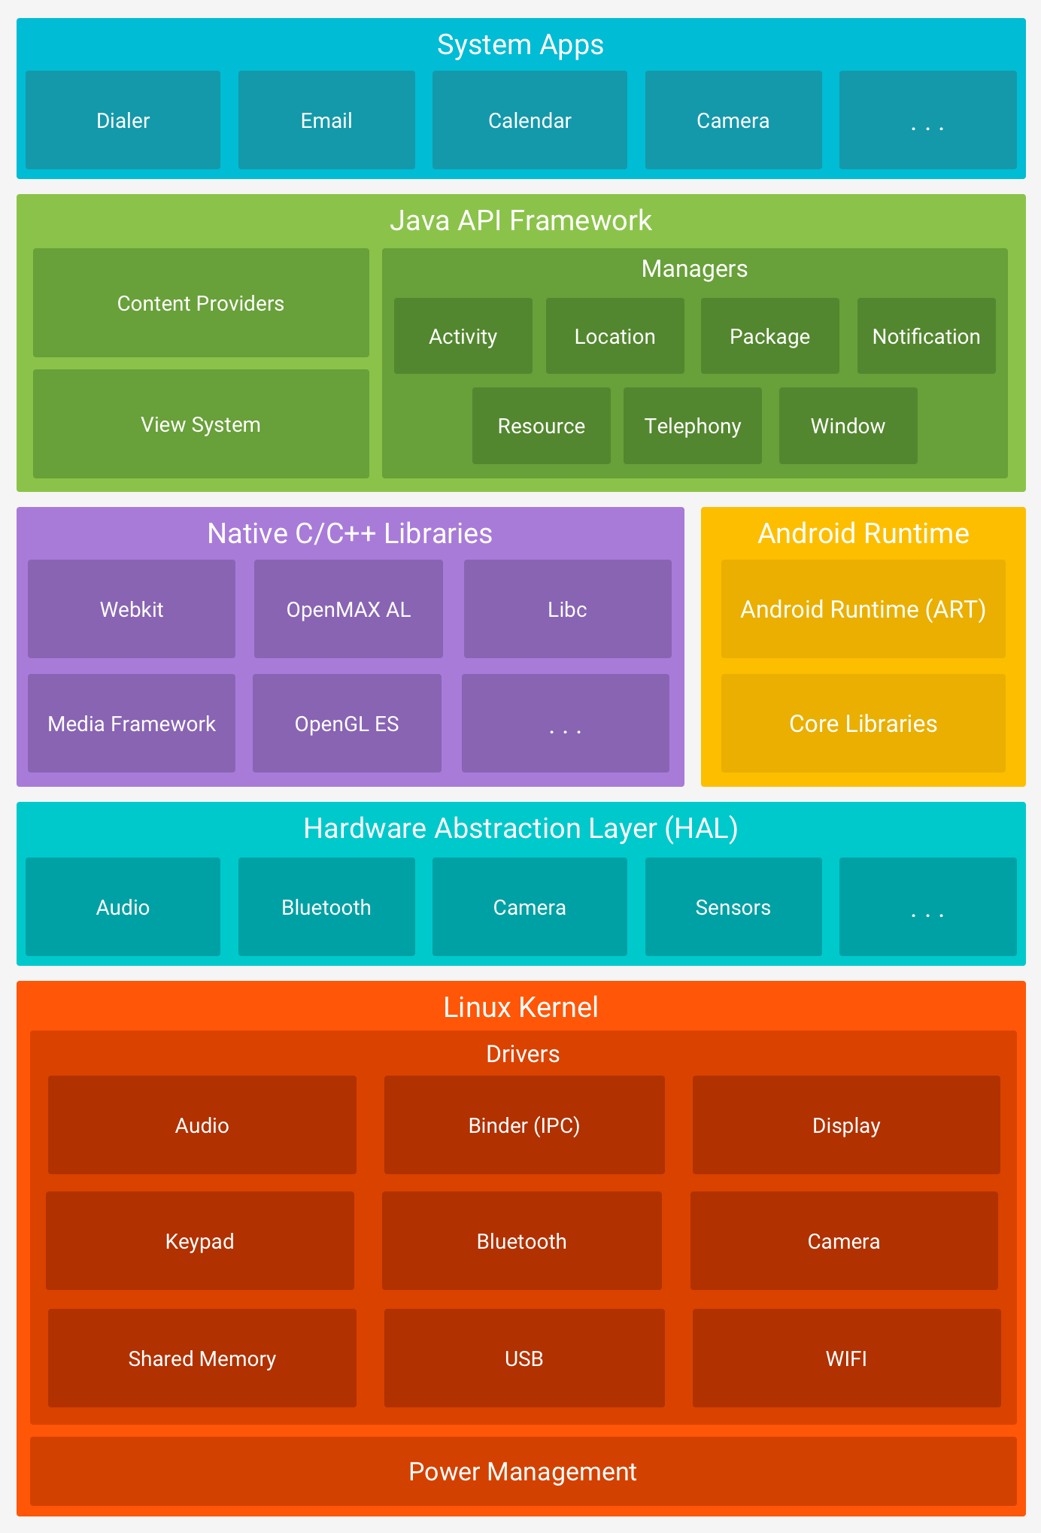
https://developer.android.com/guide/platform/

Slide 14
iOS Platform
iOS (formerly iPhone OS) is a mobile operating system created and developed by Apple Inc. exclusively for its hardware.
It is the operating system that presently powers many of the company's mobile devices, including the iPhone, iPad, and iPod Touch
The operating system manages the device hardware and provides the technologies required to implement native apps.
The operating system also ships with various system apps, such as Phone, Mail, and Safari, that provide standard system services to the user.
The iOS Software Development Kit (SDK) contains the tools and interfaces needed to develop, install, run, and test native apps that appear on an iOS device’s Home screen.

Slide 15
iOS Platform
Native apps are built using the iOS system frameworks and Objective-C language and run directly on iOS.
At the highest level, iOS acts as an intermediary between the underlying hardware and the apps that appear on the screen.
At the lower layers of the system are the fundamental services and technologies on which all apps rely; higher-level layers contain more sophisticated services and technologies.
Apple delivers most of its system interfaces in special packages called frameworks.
A framework is a directory that contains a dynamic shared library and the resources (such as header files, images, helper apps, and so on) needed to support that library.

Slide 16
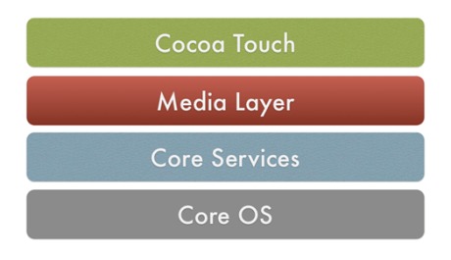
iOS Platform - Architecture

Slide 17
Cross Platform
Cross-platform development is the practice of developing software products or services for multiple platforms or software environments.
Engineers and developers use various methods to accommodate different operating systems or environments for one application or product.
Cross platform app development provide great cost saving advantage by developing one application that run over multiple platforms such as iPhone, Android, Blackberry and others.
It allows a single source development approach to deploy on various platforms with minimum changes

Slide 18
Pros of Cross-Platform Apps
Affordable and time-saver
Easy and fast deployment
Wider audience reach

Slide 19
Cons of Cross-Platform Apps
Performance glitches
User experience issues
Wrapping up

Slide 20
Type of Mobile Application
Native
Hybrid
Web
Progressive Web Apps

Slide 21
Type of Mobile Application (cont..)
Native Apps
Native mobile apps are exclusively built for a specific type of Operating system. They are called native because they are native to a particular device or platform.
Apps built on one type of operating system cannot be used on another OS. In other words, Android apps can’t be used on the iPhone.
They use the development tools and language that the respective platform supports e.g., Xcode and Objective-C with iOS, Eclipse, and Java with Android.
It provides full access to all device controls like contacts, camera, sensors, etc. The native apps ensure high performance and great user experience as the developers use the native device UI. Native apps can be accessed via respective app stores eg- Android apps on Google Play Stores, iOS apps on App Store, etc.

Slide 22
Type of Mobile Application (cont..)
Advantages of native apps:
1. Natives are very fast. 2. Easily distributed in google apple app stores. 3. More interactive and intuitive. 4. Easily interact with any feature of the phone. Disadvantages of native apps:
1. Built for a single platform 2. Languages like swift and java used to build these types of apps are hard to learn. 3. Expensive to develop. 4. hard to maintain.

Slide 23
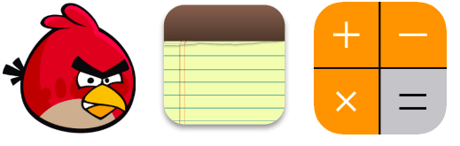
Type of Mobile Application (cont..)
Example of native application:

Slide 24
Type of Mobile Application (cont..)
Mobile Web Apps
These are the web applications to deliver web pages on web browsers running on mobile devices.
These are web-based mobile apps that do not get installed on your handheld mobile device and are run on web-hosted servers.
Mobile web apps typically use HTML, CSS, Javascript, JQuery web technologies. They cannot access all features of native device functionality(camera, calendar, geolocation, etc.).

Slide 25
Type of Mobile Application (cont..)
Advantages of web apps:
1. Reduced business cost. 2. No installation needed. 3. Better reach as it can be accessed from anywhere. 4. Always up-to-date.
Disadvantages of web apps:
1. Dependent on internet speed. 2. Interface not that sophisticated. 3. Take a longer time to develop. 4. Security risk.

Slide 26

Type of Mobile Application (cont..)
Example of web apps:

Slide 27
Type of Mobile Application (cont..)
Hybrid Apps
Hybrid apps are the mixtures of native and mobile web apps.
Like native apps, they live in an app store and can take advantage of the many device features available. Like web apps, they rely on HTML being rendered in a browser, with the caveat that the browser is embedded within the app.
These are developed using technologies like HTML, CSS, Javascript, JQuery, Mobile Javascript frameworks, Cordova/PhoneGap etc. Like Native apps, Hybrid apps are also installed in the device and distributed through the app store.
These are good for building apps that do not have a high-performance requirement but need full device access.

Slide 28
Type of Mobile Application (cont..)
Advantages of hybrid apps:
1. Easy to build 2. Much cheaper than a native app 3. Single app for all platforms. 4. No browser needed 5. Can usually access device utilities using an API 6. Faster to develop than native apps. Disadvantages of hybrid apps:
1. Slower than native apps 2. more expensive than web apps 3. Less interactive than native apps

Slide 29

Type of Mobile Application (cont..)
Example of hybrid apps:

Slide 30
Type of Mobile Application (cont..)
Progressive Web Apps
The term ‘progressive web apps were coined by designer Frances Berriman and Google Chrome engineer Alex Russell in 2015.
Progressive web apps are like regular web pages but provide additional user functionalities like working offline, push notifications and device hardware access which was earlier only available to native mobile apps.
The great thing about PWAs is that they can be accessed via app icon on the device home screen and as soon as clicked, leads to the app website. PWAs are modern technology aimed at providing a seamless mobile experience.
They are ‘native app like’, get automatically updated, are served through HTTPS so are quite safe, they can run fast regardless of operating systems and device types yet providing similar user experience and are easily installable.

Slide 31
Type of Mobile Application (cont..)
Advantages of progressive web apps:
1. Low on Data. An app which takes close to 10 MBs as a native app, can be reduced to about 500KB when made a PWA. 2. PWAs gets updated like web-pages. You get the latest version when you use. No need to update them every now and then. 3. You don’t need to install them to start using. They are simple web-pages. Users choose to ‘install’ when they like it. 4. Sharing is Easy. Unlike an app, you can share a PWA with its URL

Slide 32
Type of Mobile Application (cont..)
Disadvantages of progressive web apps:
1. PWA experience on social media is not popular these days as more and more social media companies are making their own in-app browser.
2. Plugins can’t fetch data from Facebook and Google Apps. You need to separately login on the web too.
3. Full support is not available in default browsers of some of the manufacturer's.
4. It cannot use the latest hardware advancements (like fingerprint scanner).
5. Key re-engagement features are limited to Android, such as add to home screen, notifications etc.
6. Traffic from Play Store cannot be directed to the mobile app. You miss significant traffic who use Play store for their primary search.

Slide 33

Type of Mobile Application (cont..)
Example of progressive web apps:

Slide 34
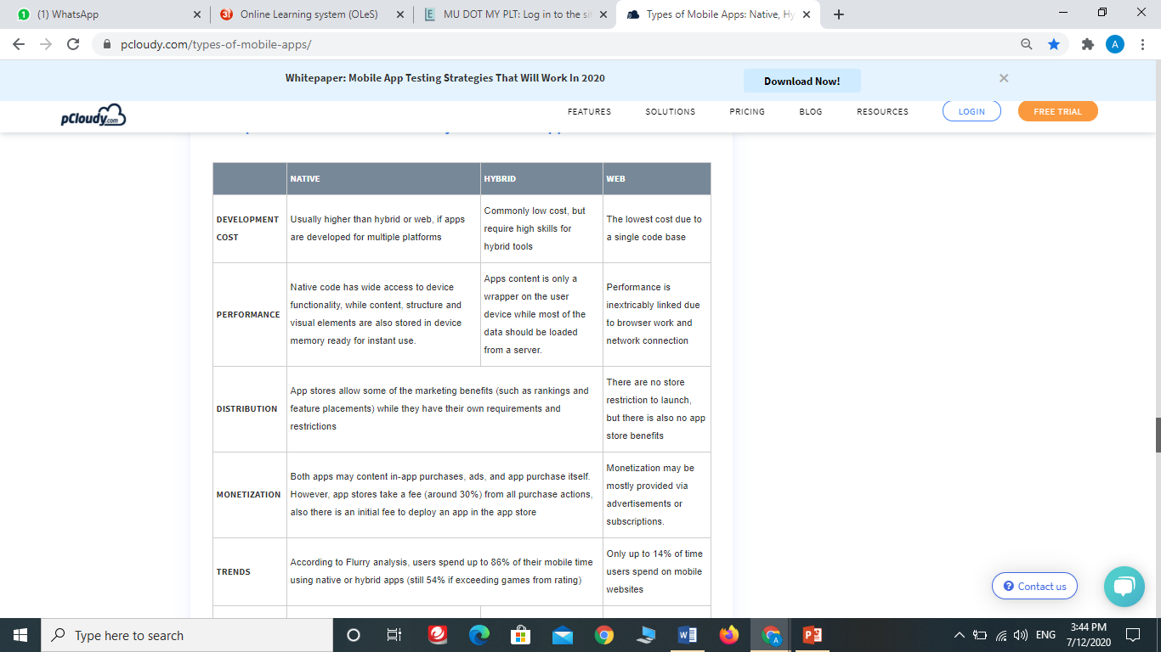

Slide 35
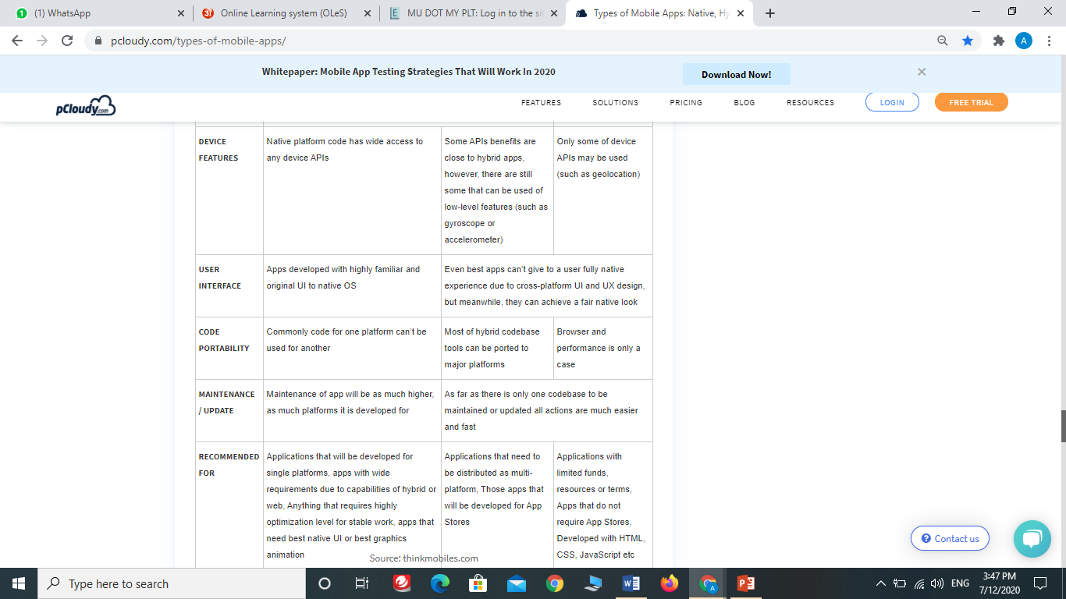

Slide 36
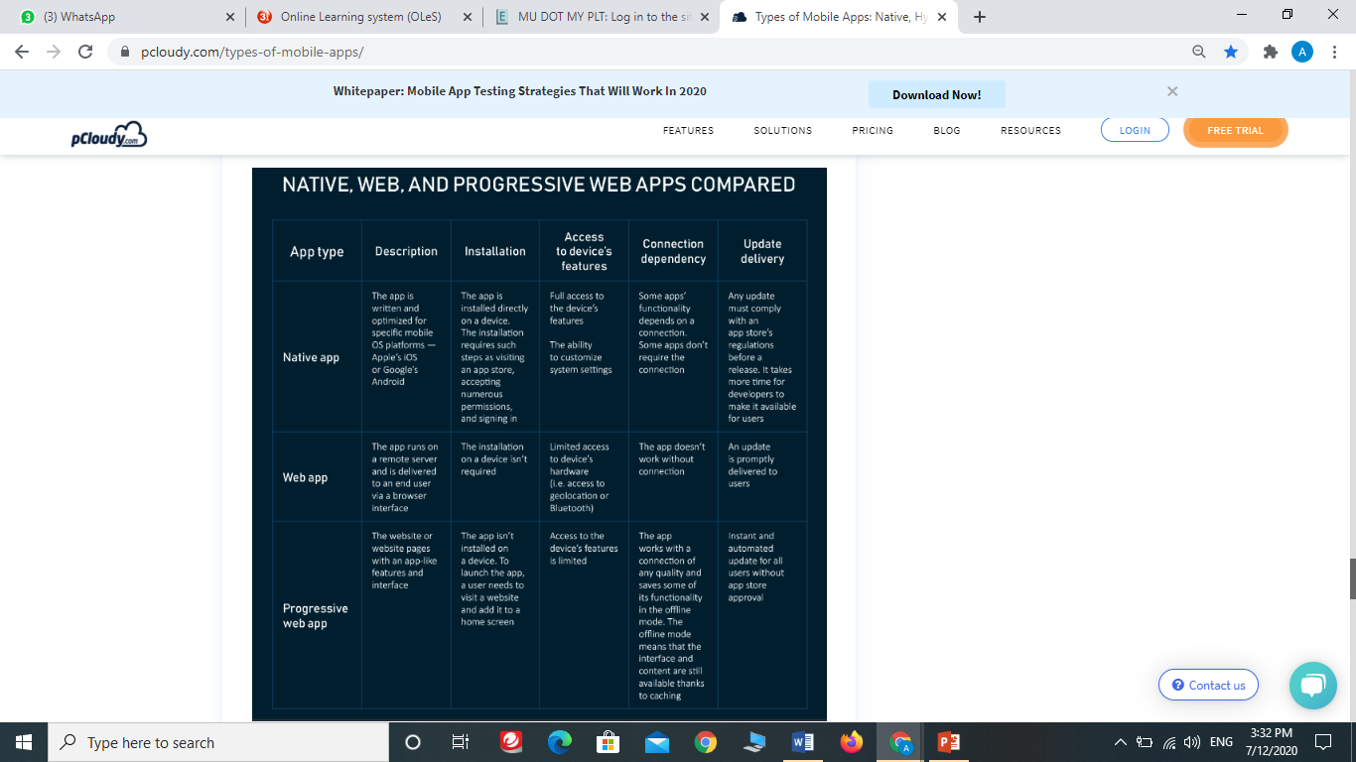

Slide 37
Tools and Programming Language BuildFire.js
This language allows mobile app developers can take advantage of the BuildFire SDK and JavaScript to create apps using BuildFire backend.
BuildFire is already programmed with features to support many common businesses.
The only thing left is for the programmer to customize the program to suit a client’s unique specifications instead of having, to build from scratch.
Advantage: it easy to work with and for developers to build apps quickly without stress.
It was designed with a flexible architecture to enable developers to use its client-side JavaScript programs like jQuery, Underscore, React, Angular, etc.

Slide 38
Tools and Programming Language BuildFire.js
The features of BuildFire.js language include:
It is easy to learn and it has a pre-programmed framework that makes it ready to use.
It provides a short-cut to mobile app development because it cuts down the time spent on developing apps
It is very scalable.
It is good for people who are just starting their first mobile app development.

Slide 39
Tools and Programming Language Python
It is a professional programming language used by top app development companies to develop desktop GUIs as well as analyzing and interpreting scientific and numeric data.
Python is a very easy language to learn and also easy to read.
Many apps have been created using Python such as Dropbox, Spotify, Instagram, BitTorrent Ubuntu Software Center, YouTube, OpenStack, Calibre, World of Tanks, Reddit, Quora etc.

Slide 40
Tools and Programming Language Python
The features of Python language include:
It is the easiest language to learn and master
It has an interactive language
It runs on different operating systems like Windows, Linux, Unix, and Mac
Python supports GUI apps
It has an object-oriented language
The interpreter processes its runtime

Slide 41
Tools and Programming Language Java
Popular Android OS uses Java which makes it a suitable mobile app language because many users use Android.
Many top app development companies have used Java for apps like Blue-ray Disc Association, UltraMixer, NASA world wind, ThinkFree cloud office etc.
Java is very popular because of its association with the Android operating system.

Slide 42
Tools and Programming Language Java
The features of Java language include:
It can run on all platforms
It supports APIs
It is very easy to read and learn
It has an object-oriented language
It has a very powerful IDEs which makes coding error-free and easy.

Slide 43
Tools and Programming Language PHP
The Hypertext Preprocessor as an open source language for server-side scripting.
PHP is also used for command line scripting and to code applications.
It is a programming language used in making websites, android apps and iOS apps.
PHP has been used for websites like Facebook, Yahoo, Flickr, Tumblr, Wikipedia etc.
PHP is used to create e-commerce websites, creating PDFs, for creating content management systems like Drupal and WordPress.

Slide 44
Tools and Programming Language PHP
PHP features include:
It is also easy to learn
It is very compatible with servers
It is an open source platform
It is both procedural and object-oriented.

Slide 45
Tools and Programming Language C++
C++ is a programming language that is object-oriented.
This programming language is used by many industries ranging from the baking to manufacturing industry.
The C++ has been used by top app development companies to develop applications for iOS, Windows, and Android.
It has also been used by top app development companies to create tools like Amazon, Google Chrome, Paypal, Photoshop, World of Warcraft etc.
C++ is amongst the most powerful programming languages

Slide 46
Tools and Programming Language C++
The features of C++ language include:
It is object-oriented
It is very easy to use and efficient
It is very fast
It is has a massive library

Slide 47
Discussion
Find the latest tools for mobile application development and identify type of apps can be developed by the tools.
Language used
Type of apps

